Slide 1
Cut 90-day churn from 22% to 18% with 3 tests
VIDEO+ | EXECUTIVE SUMMARY FOR THE CMO
Problem
164K of 734K subscribers cancel within 90 days: R$ 12.6M of monthly revenue at risk.
Solution
Stop known leaks (payment, promotions, media) and act by behavior group.
Impact
R$ 4.0M net margin per 90-day cycle (range: -R$ 0.1M to R$ 5.4M).
Ask
Approve 3 tests of 90 days on 10% of the base, with a R$ 0.15M cap on variable cost.
Notes:
Synthetic base of 1.92 million subscriptions; numbers show the method and order of magnitude and will be recalibrated with real data within 30 days.

Slide 2
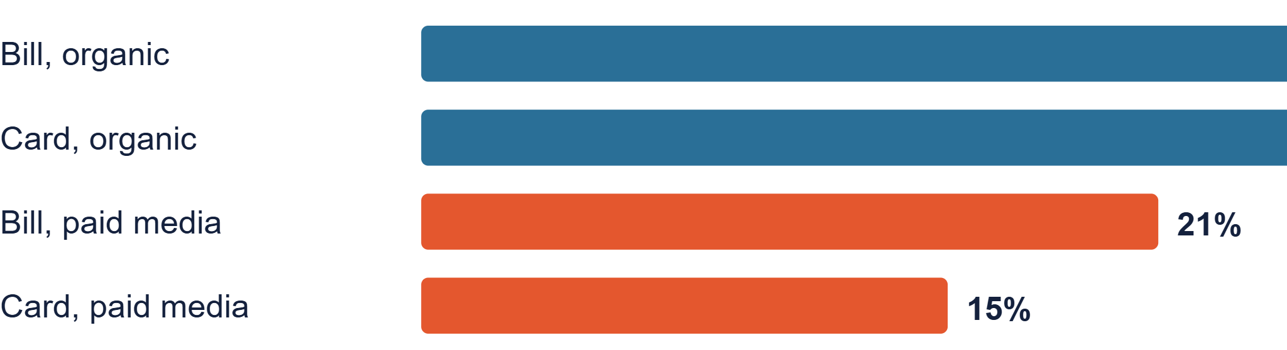
AS-IS: 1 in 4 subscribers leaves within 90 days
734K
R$ 53.6M
22%
R$ 12.6M
active subscribers
monthly list revenue
cancel within 90 days
monthly revenue at risk
12-month retention by origin and acquisition
Bill = charged on the Claro telecom bill. Card = credit card (internet customers).
video+ | synthetic data, estimates to be validated | 2
Notes:
Mix of 65% bill and 35% card (±5 p.p. per month); 30K paid and 50K organic new subscribers per month.

Slide 3
Three leaks explain most of the loss
R$ 120 vs R$ 104
47% vs 17%
36% | 26%
Cycle-2 cancellation with and without an entry coupon on card (bill: 27% vs 12%)
Card: 36% of cancellations are payment failures. Bill: 14% collateral and 12% delinquency
Paid media on card: 12-month margin barely covers CAC; 9-month payback (bill: 5)
On the Family plan, 40% off leaves the margin of the first 2 months at -2% of price; on Telecine it stays at +18%.
video+ | synthetic data, estimates to be validated | 3
Notes:
12-month margin and average CAC of paid media on card; cycle-2 churn by origin; cancellation types by origin.

Slide 4
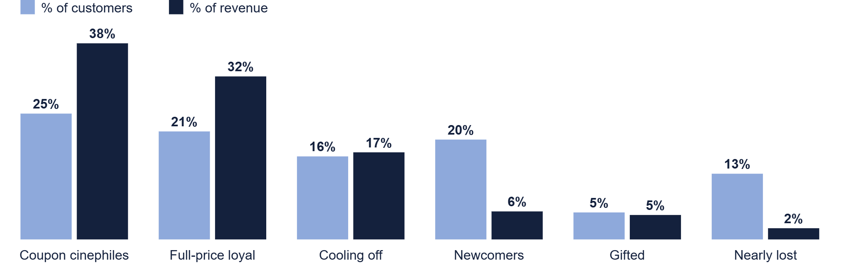
70% of revenue sits in 2 of the 6 groups; 13% of customers are worth 2%
90-day cancellation: Coupon cinephiles 12%, Full-price loyal 10%, Cooling off 27%, Newcomers 19%, Gifted 29%, Nearly lost 51%.
video+ | synthetic data, estimates to be validated | 4
Notes:
k-means with k=6 (ARI 0.95 across seeds). Silhouette 0.22: continuous structure.

Slide 5
Recommendations: from AS-IS to TO-BE
Lever
AS-IS
Recommendation
Paid media
Same for bill and card; high CAC
Prioritize Claro base audiences; cut Display on card
Entry promotion
40% off on every plan
Coupons only where they pay back: Telecine yes, Premiere in windows, Family with a benefit, not % off
Payment
Card failures and delinquency without a dunning flow
Dunning on card; move billing to PIX/bill when a Claro product is cancelled
Retention
Same approach for everyone
Action by group and plan; offers only to at-risk customers with value
Gifted customers
No invitation at month 3
Continuity email tested in A/B (offer vs personal proof)
video+ | synthetic data, estimates to be validated | 5
Notes:
Each recommendation has its own tab in the study (Playbook, Coupons by plan, Channels, Gifted email).

Slide 6
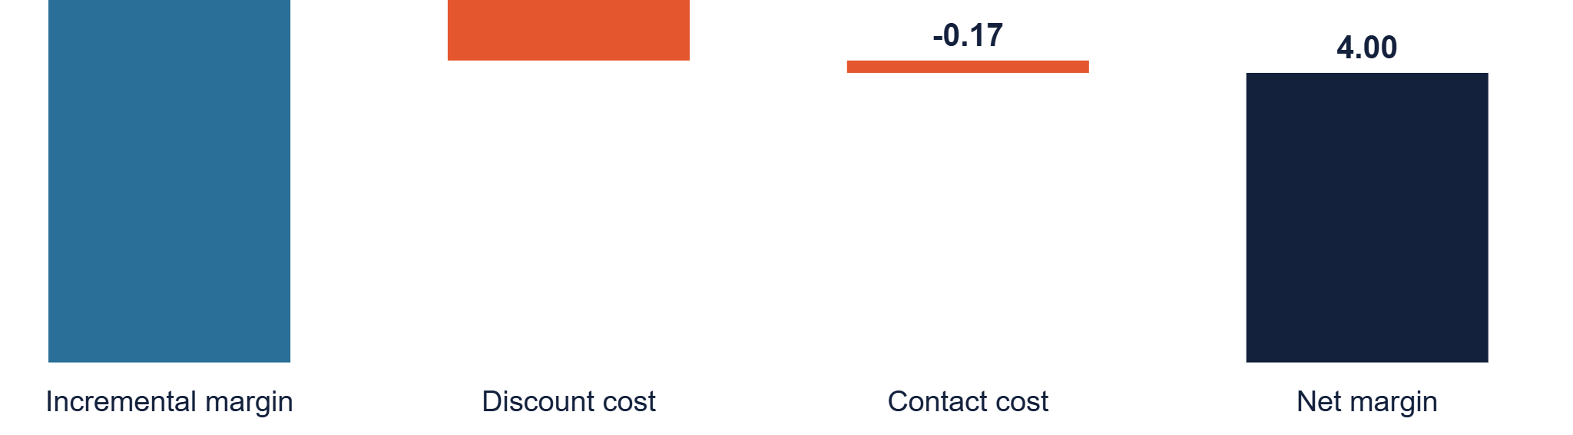
Impact per 90-day cycle: from -R$ 0.1M to R$ 5.4M, base R$ 4.0M
-R$ 0.1M
R$ 4.0M
R$ 5.4M
Pessimistic: half the save rate and 3 extra months of retention
Base: 28K customers retained (15K by actions + 13K by payment recovery)
Optimistic: save rate 25% higher
Excludes staff and tools. The discount (R$ 1.3M) is the main risk; the tests define how much of it is needed. Payment recovery accounts for 58% of the result at a cost of R$ 0.1M.
video+ | synthetic data, estimates to be validated | 6
Notes:
Pessimistic = recovery and save rates x0.5 and 3 extra months; optimistic = x1.25. Return of the group playbook: 1.2x.

Slide 7
90-day plan: 3 tests with a decision gate
Test
Hypothesis
Pilot and owner
Target and gate (day 90)
1. Payment
Recover 30% of card cancellations and 20% of collateral cancellations
10% of the base; Payments and CRM
Recovery ≥ 20%; net result > 0
2. Coupon by plan
Family without % off (benefit) and Premiere only in windows yield equal or higher margin
Coupon vs benefit vs none; Product and Pricing
12-month margin ≥ no coupon; incrementality ≥ 30%
3. Retention and gifts
Cooling off and Newcomers respond to action; month-3 email converts +2 p.p.
Cooling off, Newcomers and 14K gifted; CRM
Save rate ≥ 25%; conversion 10% → 12%
Consolidated target: 90-day cancellation from 22.4% to 18.5%. In parallel (30 days): recalibrate CAC, margin, cancellation and NPS with real data.
video+ | synthetic data, estimates to be validated | 7
Notes:
Day 90: scale what passes the gate; stop what does not. The email test needs ~14K customers (about 5 months of base).

Slide 8
Decision requested today
1
Approve 3 tests of 90 days
Payment, coupon by plan and retention by group, on 10% of the base.
2
Cap of R$ 0.15M per cycle
Variable cost of contact and discounts in the pilot; staff and tools to be defined with Finance.
3
Release real data within 30 days
CAC, margin, cancellation and NPS to recalibrate the model.
4
Name owners and set the day-90 gate
Payments, Product and Pricing, CRM. No price changes or channel cuts before the tests.
video+ | synthetic data, estimates to be validated | 8
Notes:
If the gate fails, the maximum cost is the approved cap.

Slide 9
Appendix: month-3 email, the two finalists
G2 | Offer (average 4.0)
P2 | Personal proof (average 3.7)
Subject: First month on your own plan with 40% off
Subject: You watched {hours} hours in 3 months
First line: So you can pick up where you left off, your first month on your own subscription is 40% off.
First line: In 3 months you watched {hours} hours and {titles} titles with your gift; a good sign of what suits you.
Body: Choose your plan and continue: R$ {final price} for the 1st month, then R$ {price}. First charge on {date}.
Body: Pick up where you left off: choose the plan with the channels you use most, from R$ {price} per month.
Button: Continue with my subscription
Button: Choose my plan
Risk: the offer must be approved; show the final price in R$ and the first charge date.
Risk: depends on correct usage data and privacy care (LGPD).
video+ | synthetic data, estimates to be validated | 9
Notes:
Customer-facing messages will be sent in Portuguese; the English text is a translation for review. Variables in braces come from the CRM.

Slide 10
Appendix: push, finalists and messages by group
Gifted customers (day 85 and 88)
By CRM group
G2: "Your 1st month at 40% off" | Pick up where you left off on video+. See the final price.
Cinephiles: "The premiere is here" | Rent it with your coupon.
Cooling off: "You have been away a few days" | See what is new in your plan.
P2: "{hours}h of video+ in 3 months" | Pick up where you left off: choose your plan.
Newcomers: "Your first 3 titles" | Start here.
Reminder: "Your gift ends in {days} days" | Only with a confirmed date and no alarmist tone.
Loyal: "Early premiere access for you" | No coupon.
Channel: push in the app and email; bill customers also get WhatsApp.
Test: send time; maximum 2 pushes per week.
video+ | synthetic data, estimates to be validated | 10
Notes:
Push with a short title and a body of up to 90 characters. Customer-facing text will be sent in Portuguese.

